Slide 1

Introduction to Analytic Methods, Types of Data Mining for Analytics & Introduction to Group 2
Thilanka Munasinghe
Data Analytics
ITWS-4600/ITWS-6600/MATP-4450/CSCI-4960
Group 1, Module 4, February 8th, 2021

Slide 2
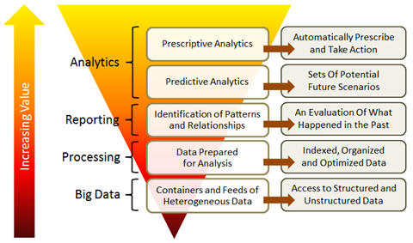
Contents
Reminder: PDA/EDA, models
Patterns/ Relations via “Data mining”
Interpreting results
Saving the models
Proceeding with applying the models
Notes:
PDA: Preliminary Data Analysis
EDA: Exploratory Data Analysis

Slide 3
Preliminary Data Analysis
Relates to the sample v. population
Also called Exploratory DA
“EDA is an attitude, a state of flexibility, a willingness to look for those things that we believe are not there , as well as those we believe will be there” (John Tukey)
Distribution analysis and comparison, visual ‘analysis’, model testing, i.e. pretty much the things you did last lab and will do more of!

Slide 4
Models
Assumptions are often used when considering models, e.g. as being representative of the population – since they are so often derived from a sample – this should be starting to make sense (a bit)
Two key topics:
N=all and the open world assumption
Model of the thing of interest versus model of the data (data model; structural form)
“All models are wrong but some are useful” (generally attributed to the statistician ~ George Box)
Notes:
generally attributed to the statistician George Box -- https://en.wikipedia.org/wiki/All_models_are_wrong
OWA – data is can be incomplete, data can be wrong,
https://en.wikipedia.org/wiki/Open-world_assumption
In a formal system of logic used for knowledge representation, the open-world assumption is the assumption that the truth value of a statement may be true irrespective of whether or not it is known to be true. It is the opposite of the closed-world assumption, which holds that any statement that is true is also known to be true.
The open-world assumption (OWA) codifies the informal notion that in general no single agent or observer has complete knowledge, and therefore cannot make the closed-world assumption. The OWA limits the kinds of inference and deductions an agent can make to those that follow from statements that are known to the agent to be true. In contrast, the closed world assumption allows an agent to infer, from its lack of knowledge of a statement being true, anything that follows from that statement being false.

Slide 5
Art or science?
The form of the model, incorporating the hypothesis determines a “form”
Thus, as much art as science because it depends both on your world view and what the data is telling you (or not)
We will however, be giving the models nice mathematical properties

Slide 6
Patterns and Relationships
Group 2 - Patterns, relations, descriptive analytics
Stepping from elementary/ distribution analysis to algorithmic-based analysis
I.e. pattern detection via data mining: classification, clustering, rules; machine learning; support vector machines, non-parametric models
Relations – associations between/among populations
Outcome: model and an evaluation of its fitness for purpose
Notes:
Group 2 - Patterns, relations, descriptive analytics
https://tw.rpi.edu/web/Courses/DataAnalytics/2020Fall

Slide 7
Data Mining = Patterns
Classification (Supervised Learning)
Classifiers are created using labeled training samples
Training samples created by ground truth / experts
Classifier later used to classify unknown samples
Clustering (Unsupervised Learning)
Grouping objects into classes so that similar objects are in the same class and dissimilar objects are in different classes
Discover overall distribution patterns and relationships between attributes
Association Rule Mining
Initially developed for market basket analysis
Goal is to discover relationships between attributes
Uses include decision support, classification and clustering
Other Types of Mining
Outlier Analysis
Concept / Class Description
Time Series Analysis
Notes:
Data Mining invented /introduced to the world by an PRI professor http://ise.rpi.edu/people/mark-embrechts
Metaphorically he used the term “mining” to represent the “knowledge representation”.

Slide 8
Models/ types
Trade-off between Accuracy and Understandability
Models range from “easy to understand” to incomprehensible
Decision trees
Rule induction
Multi-Regression models
Neural Networks
Deep Learning
Harder

Slide 9
Patterns and Relationships
In Group 2 - Patterns, relations, descriptive analytics
Linear and multi-variate
Nearest Neighbor
Training.. (supervised)
K-means
Clustering.. (un-supervised) and classification

Slide 10
The Dataset(s)
Open the multivariate.xls and explore the data
What are your observations ?
What can you say about the data set ?
Same dataset is available as simple multivariate.csv
(http://aquarius.tw.rpi.edu/html/DA )
Additionally, another dataset;
nytimes/ nyt<n> and “sales”

Slide 11
Regression in Statistics
Regression is a statistical process for estimating the relationships among variables
Includes many techniques for modeling and analyzing several variables
When the focus is on the relationship between a dependent variable and one or more independent variables
Independent variables are also called basis functions
Estimation is often by constraining an objective function
Must be tested for significance, confidence
Notes:
wikipedia

Slide 12
Objective function

Slide 13
Constraint function(s)

Slide 14
regression…

Slide 15
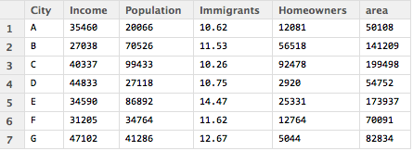
Linear basis and least-squares constraints
> multivariate <- read.csv("~/Documents/teaching/DataAnalytics/data/multivariate.csv")
> attach(multivariate)
> mm<-lm(Homeowners~Immigrant)
> mm
Call:
lm(formula = Homeowners ~ Immigrants)
Coefficients:
(Intercept) Immigrants
107495 -6657
dependent variable
independent variable
Notes:
“mm” here is a R-Object
What can you say about the immigrant column?
Immigrants column is percentage value -- 10.62% of the population

Slide 16
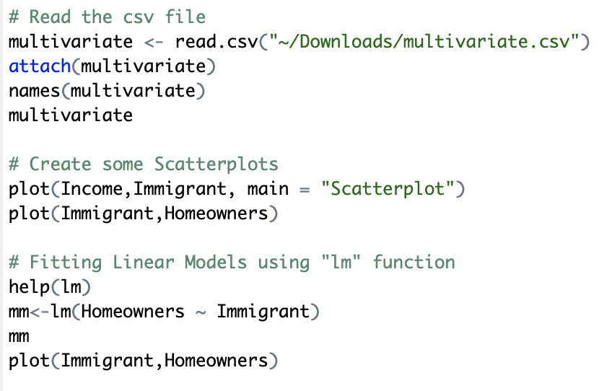
In Class Work

Slide 17
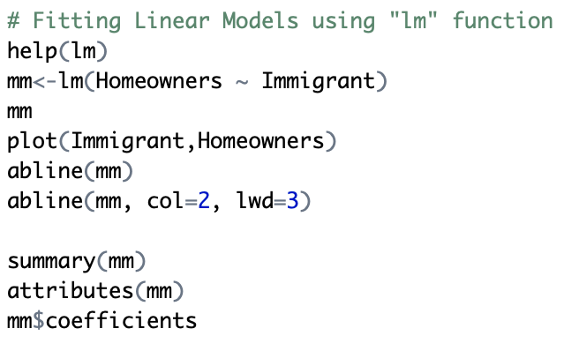
In Class Work

Slide 18
Linear fit?
plot(Homeowners ~ Immigrants)
Find out how you can
Draw a line using
>help(abline)
Notes:
Does this line fit any data points ? No
What is your objective here ? What is the “Objective Function” here ? Your objective is here to see any relationship.
We are getting a descriptive statistics about the sample.
I drew the line using “abline” in R. http://www.sthda.com/english/wiki/abline-r-function-an-easy-way-to-add-straight-lines-to-a-plot-using-r-software
There is an “inverse relationship” here

Slide 19
Linear fit?
plot(Homeowners~Immigrants)
Find out how you can
Draw a line using
>help(abline)
Does this line fit any data points ? No
Notes:
Does this line fit any data points ? No
What is your objective here ? What is the “Objective Function” here ? Your objective is here to see any relationship.
We are getting a descriptive statistics about the sample.
There is an “inverse relationship” here

Slide 20
Analysis – i.e. Science question
We want to see if there is a relation between immigrant population and the mean income, the overall population, the percentage of people who own their own homes, and the population density.
To do so we solve the set of 7 linear equations of the form:
%_immigrant = a x Income + b x Population + c x Homeowners/Population + d x Population/area + e

Slide 21
Multi-variate (during the Lab Work)
Figure out how to include multiple independent variables
> HP<- Homeowners/Population
> PD<-Population/area
> mm<-lm(Immigrants~Income+Population+HP+PD)
> summary(mm)
Call:
lm(formula = Immigrants ~ Income + Population + HP + PD)

Slide 22
Multi-variate
> cm<-coef(mm)
> cm
(Intercept) Income Population hp pd
2.454544e+01 -1.130049e-04 5.443904e-05 -6.533818e-02 -1.773908e-01
These linear model coefficients can be used with the predict.lm function to make predictions for new input variables. E.g. for the likely immigrant % given an income, population, %homeownership and population density
Oh, and you would probably try less variables?

Slide 23
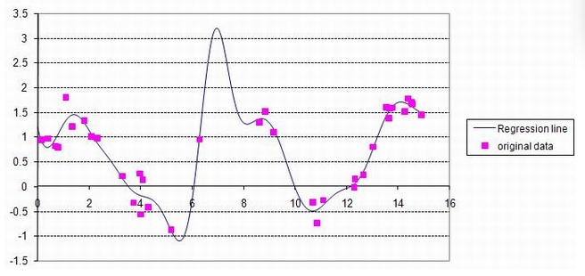
When it gets complex…

Slide 24
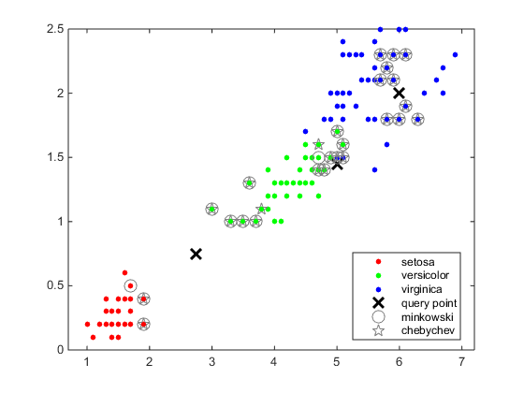
Notes:
http://www.mathworks.com/help/examples/stats/ClassifyUsingKNearestNeighborsExample_01.png

Slide 25
K-nearest neighbors (knn)
Can be used in both regression and classification (“non-parametric”)
Is supervised, i.e. training set and test set
KNN is a method for classifying objects based on closest training examples in the feature space.
An object is classified by a majority vote of its neighbors. K is always a positive integer. The neighbors are taken from a set of objects for which the correct classification is known.
It is usual to use the Euclidean distance, though other distance measures such as the Manhattan distance could in principle be used instead.
Notes:
~ http://www.codeproject.com/Articles/32970/K-Nearest-Neighbor-Algorithm-Implementation-and-Ov

Slide 26
Algorithm
The algorithm on how to compute the K-nearest neighbors is as follows:
Determine the parameter K = number of nearest neighbors beforehand. This value is all up to you.
Calculate the distance between the query-instance and all the training samples. You can use any distance algorithm.
Sort the distances for all the training samples and determine the nearest neighbor based on the K-th minimum distance.
Since this is supervised learning, get all the categories of your training data for the sorted value which fall under K.
Use the majority of nearest neighbors as the prediction value.
Notes:
http://www.codeproject.com/Articles/32970/K-Nearest-Neighbor-Algorithm-Implementation-and-Ov

Slide 27
Distance metrics
Euclidean distance is the most common use of distance. When people talk about distance, this is what they are referring to. Euclidean distance, or simply 'distance', examines the root of square differences between the coordinates of a pair of objects. This is most generally known as the Pythagorean theorem.
The taxicab metric is also known as rectilinear distance, L1 distance or L1 norm, city block distance, Manhattan distance, or Manhattan length, with the corresponding variations in the name of the geometry. It represents the distance between points in a city road grid. It examines the absolute differences between the coordinates of a pair of objects.
Notes:
http://www.codeproject.com/Articles/32292/Quantitative-Variable-Distances

Slide 28
More generally
The general metric for distance is the Minkowski distance. When lambda is equal to 1, it becomes the city block distance, and when lambda is equal to 2, it becomes the Euclidean distance. The special case is when lambda is equal to infinity (taking a limit), where it is considered as the Chebyshev distance.
Chebyshev distance is also called the Maximum value distance, defined on a vector space where the distance between two vectors is the greatest of their differences along any coordinate dimension. In other words, it examines the absolute magnitude of the differences between the coordinates of a pair of objects.
Notes:
http://www.codeproject.com/Articles/32292/Quantitative-Variable-Distances

Slide 29
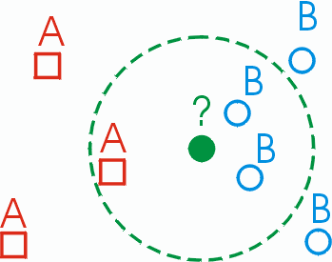
Choice of k?
Don’t you hate it when the instructions read: the choice of ‘k’ is all up to you ??
Loop over different k, evaluate results…
Notes:
http://cgm.cs.mcgill.ca/~soss/cs644/projects/perrier/Image25.gif

Slide 30
What does “Near” mean…
More on this in the next topic but …
DISTANCE – and what does that mean
RANGE – acceptable, expected?
SHAPE – i.e. the form

Slide 31
Training and Testing
We are going to do much more on this going forward…
Regression (un-supervised) – uses all the data to ‘train’ the model, i.e. calculate coefficients
Residuals are differences between actual and model for all data
Supervision means not all the data is used to train because you want to test on the untrained set (before you predict for new values)
What is the ‘sampling’ strategy for training? (1b)

Slide 32
Summing up ‘knn’
Advantages
Robust to noisy training data (especially if we use inverse square of weighted distance as the “distance”)
Effective if the training data is large
Disadvantages
Need to determine value of parameter K (number of nearest neighbors)
Distance based learning is not clear which type of distance to use and which attribute to use to produce the best results. Shall we use all attributes or certain attributes only?
Computation cost is quite high because we need to compute distance of each query instance to all training samples. Some indexing (e.g. K-D tree) may reduce this computational cost.
Notes:
http://www.codeproject.com/Articles/32970/K-Nearest-Neighbor-Algorithm-Implementation-and-Ov

Slide 33
K-means
Unsupervised classification, i.e. no classes known beforehand
Types:
Hierarchical: Successively determine new clusters from previously determined clusters (parent/child clusters).
Partitional: Establish all clusters at once, at the same level.

Slide 34
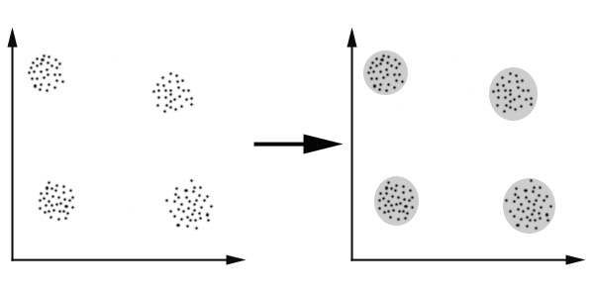
Distance Measure
Clustering is about finding “similarity”.
To find how similar two objects are, one needs a “distance” measure.
Similar objects (same cluster) should be close to one another (short distance).

Slide 35
Distance Measure
Many ways to define distance measure.
Some elements may be close according to one distance measure and further away according to another.
Select a good distance measure is an important step in clustering.

Slide 36
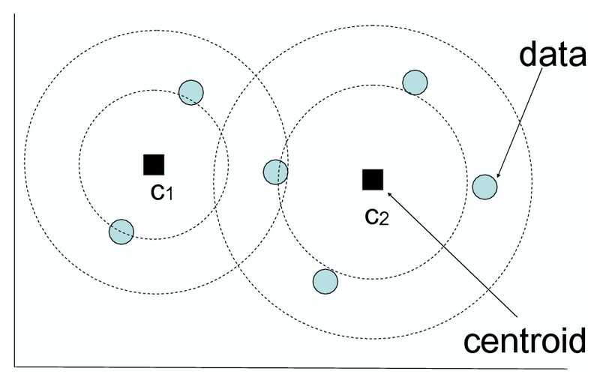
K-Means Clustering
Separate the objects (data points) into K clusters.
Cluster center (centroid) = the average of all the data points in the cluster.
Assigns each data point to the cluster whose centroid is nearest (using distance function.)

Slide 37
K-Means Algorithm
Place K points into the space of the objects being clustered. They represent the initial group centroids.
Assign each object to the group that has the closest centroid.
Recalculate the positions of the K centroids.
Repeat Steps 2 & 3 until the group centroids no longer move.

Slide 38
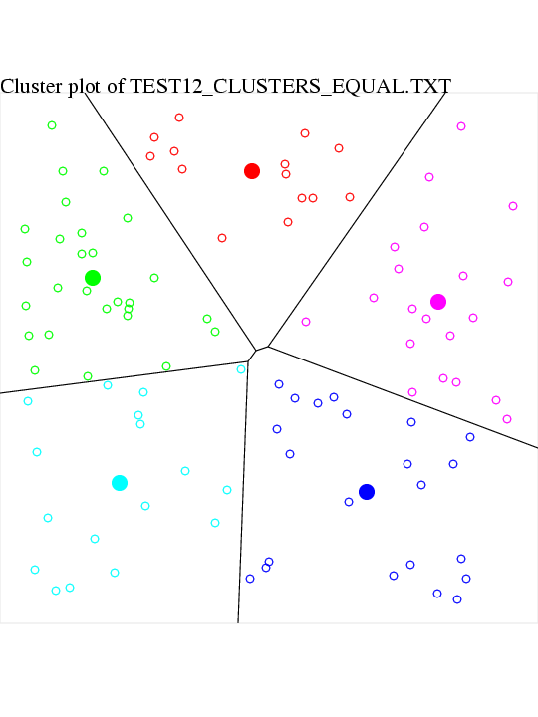
K-Means Algorithm: Example Output

Slide 39
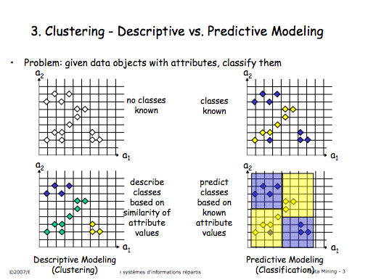
Describe v. Predict
More on this later in Group 2 …

Slide 40
K-means
"Age","Gender","Impressions","Clicks","Signed_In"
36,0,3,0,1
73,1,3,0,1
30,0,3,0,1
49,1,3,0,1
47,1,11,0,1
47,0,11,1,1
(nyt datasets)
Model e.g.: If Age<45 and Impressions >5 then Gender=female (0)
Age ranges? 41-45, 46-50, etc?

Slide 41
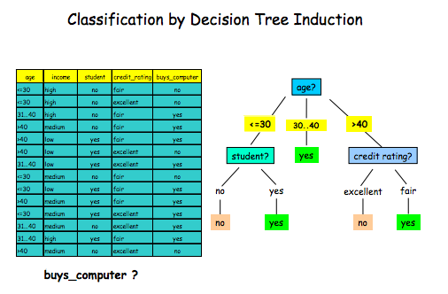
Decision tree classifier
More on this later in Group 2 …

Slide 42
Predict = Decide
More on this later in Group 2 …

Slide 43
Visualization
Scatter Plot – Paired data (x,y)
Describe the relationship between numerical variables.
Make a note on the direction of the data points
Positive direction
Negative Direction
Check for unusual observations
See the relationship - Linear or Non-linear

Slide 44
We’ll do more during up coming lectures/labs..
We will move to Group 2: Patterns, relations, descriptive analytics

Slide 45



Possible Project Ideas for the Data Analytic Course
Sustainable Development Goals (SDG) using UN Data
https://www.un.org/sustainabledevelopment/sustainable-development-goals/
Watch:https://www.youtube.com/watch?time_continue=4&v=0XTBYMfZyrM&feature=emb_logo&ab_channel=UnitedNations
https://www.un.org/sustainabledevelopment/
https://data.un.org/
https://www.un.org/en/sections/issues-depth/big-data-sustainable-development/index.html
Watch:https://www.youtube.com/watch?v=yobFJniliOs&feature=emb_logo&ab_channel=WesternDigitalCorporation
Watch: https://www.youtube.com/watch?v=v-zGHqMyd7o&feature=emb_logo&ab_channel=UNGlobalPulse

Slide 46

UN Data
https://www.un.org/sustainabledevelopment/

Slide 47
Project Dataset Selection
Project Dataset selection (some of you have already chosen a dataset by now, if not, you need to do it today)
Dataset Check-in (documenting your dataset:URLs/Weblinks/Repository information)
Next Week: Virtual One-on-One with the instructor to check-in your Project dataset
Dataset cleaning/preparation
Conducting EDA on your project dataset and preliminary analysis begins

Slide 48
Dataset search
If you have not chosen a dataset so far, please search online and select datasets using search tools such as
https://datasetsearch.research.google.com/
If you need help choosing a dataset, please come and talk to me during the class time or during virtual office hours, so that I can guide/help you to select datasets.
NOTE: 6000-Level students MUST have TWO datasets (minimum two datasets) used during final project.

Slide 49
More places to find data:
US Government Data: https://www.data.gov/
US Department of Agriculture: https://www.nass.usda.gov/Data_and_Statistics/index.php
Center of Disease Control (CDC): https://www.cdc.gov/datastatistics/index.html
US Financial Data: https://www.federalreserve.gov/data.htm
European Union Open Data Portal: https://data.europa.eu/euodp/en/data/

Slide 50
Some Conferences that you can submit your Data Analytics project
IEEE GHTC2021 (Global Humanitarian Technology Conference) This is aUN Sustainable Development Goals related conference. Paper deadline May 1st 2021
https://ieeeghtc.org/
IEEE DSAA2021 (Data Science and Advanced Analytics)
Paper deadline May 23rd 2021
https://dsaa2021.dcc.fc.up.pt/calls/important-dates

Slide 51
ACM GoodIT2021 (International Conference on Information Technology for Social Good
http://www.grc.upv.es/goodit2021/authors/#important-dates

Slide 52
Read: Chapter 3 - Linear Regression
Read: Chapter 3 (Linear Regression), Introduction to Statistical Learning with Applications in R, 7th Edition
Next: Lab2 (Assignment 2) on Thursday.

